Slide 1

EY Techathon 6.0 Detailed Submission
Date of submission: 17-12-2025

Slide 2



Team Name : Neural Nexus
Problem Statement : IT/BPM (FirstSource) - Provider Data Validation and Directory Management Agent for Healthcare Payers
Team Member 1
Name : Mohammed Azeez Khan
College name : National Institute of Technology, Warangal
Contact Detail : 9515703575
Role in Solution Development : Agentic Logic & Integration Lead
Team Member 2
Name : Ummul Faiz
College name : Nawab Shah Alam Khan College of Engineering and Technology
Contact Detail : 9676386870
Role in Solution Development : UI/UX & Interaction Designer

Slide 3
HealthGuard AI – Autonomous Agentic Verification for Validated Healthcare Networks
Executive Summary
The Indian healthcare ecosystem loses an estimated ₹2,400 crore annually to fraud and inefficiencies within provider networks, primarily driven by “ghost doctors” and non‑compliant medical facilities. Traditional verification methods are manual, expensive (~₹8,000/provider), and prohibitively slow (5–7 days turnaround), making real‑time compliance for schemes like PM‑JAY nearly impossible.
HealthGuard AI bridges this gap by deploying an autonomous “Agentic AI” workflow that validates healthcare providers in real time. Unlike static rule‑based systems, our solution employs LangGraph orchestration to manage stateful validation agents. These agents autonomously query disparate data sources—simulating National Medical Commission (NMC) registry checks and performing satellite‑based geocoding via OpenStreetMap—to corroborate provider identity and physical existence.

Slide 4
HealthGuard AI – Autonomous Agentic Verification for Validated Healthcare Networks
Our solution introduces a novel Trust Scoring Engine that synthesizes multi‑modal data into a single verified confidence score. Critical failures (e.g., expired licenses) trigger immediate rejection logic, ensuring zero‑tolerance for fraud.
By automating the entire pipeline, HealthGuard AI:
Reduces verification costs by up to 90%
Shrinks turnaround time from days to seconds
Scales as a containerized microservice that insurers and government bodies can deploy rapidly
This enables instant creation of trustworthy provider networks and ensures that every rupee spent on healthcare goes to a legitimate, validated provider

Slide 5
Problem Context & Users
Target Industry
Healthcare Payers (Health Insurance Companies)
Government Schemes (Ayushman Bharat / PM‑JAY)
Industry Type
B2B / B2G
User Persona
Network Management Teams
Fraud Control Units (FCU)
Compliance Officers
User Department
Provider Network Operations (empanelment, credentialing, anti‑fraud)

Slide 6
Problem Scenario
Current Empanelment Flow (Pain Points)
Network Manager receives a request to empanel a new clinic.
Today, verification relies on manual document checks and field visits.
This leads to:
Long Time‑to‑Empanelment (weeks)
High operational cost per provider
Risk of ghost clinics/doctors slipping through
Desired Experience with HealthGuard AI
Manager opens the HealthGuard Dashboard.
Enters doctor’s registration number and clinic address.
System instantly:
Validates credentials
Shows clinic location on a satellite map
Flags issues (e.g., expired license, residential address)

Slide 7
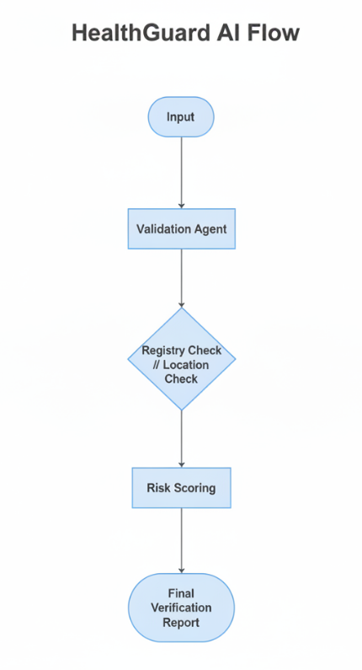
Proposed Data Flow
Input
User submits Provider Dictionary via Web UI:
Name, Registration Number, Address
Orchestration – Validation Agent
Receives the request and spawn's parallel tasks:
Path A – Registry Check
Hits NMC/State Council (simulated) for licensure status.
Path B – Geolocation Check
Uses OpenStreetMap API to resolve lat/long and confirm address existence.
Synthesis – Score Engine
Aggregates outputs from Path A & B.
If Registry Status = “Expired” → Trust Score = 0 (Critical Failure).
Else → Trust Score = weighted average of Validity + Location Match.
Output
JSON rendered on Dashboard: Status (Verified/Flagged), Trust Score, Evidence Logs.

Slide 8
Solution & Value Proposition
Nature of Output
Responsive Web Application (React Dashboard) with:
Real‑time status tracking
Interactive map view
Downloadable verification reports (PDF)
Value Proposition
Cost Efficiency – Eliminates routine field visits for Tier‑1 checks.
Speed – Time‑to‑Empanelment drops from weeks to minutes.
Risk Mitigation – Automated “AI Risk Assessment” prevents human oversight for critical failures.
Impact Metrics
Turnaround Time: 5 days → < 5 seconds per provider
Cost per Verification: ₹500 → ₹5 (compute)
Accuracy: Zero false positives for critical failures (e.g., expired license).

Slide 9
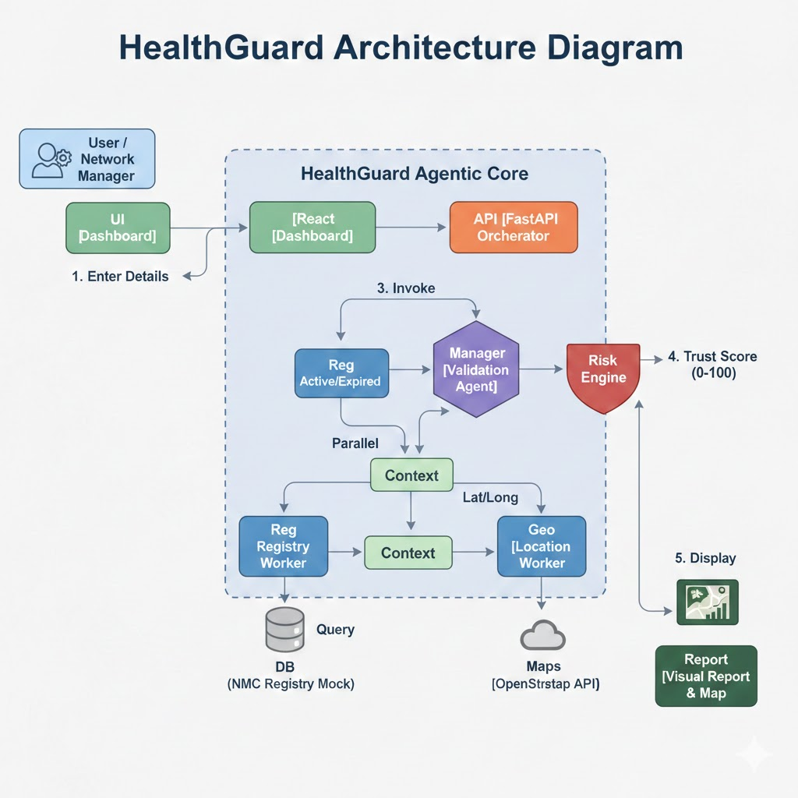
Tech Stack & Architecture
Technologies Used
Frontend: React.js, Vite, Lucide React (icons)
Backend: Python FastAPI, Uvicorn
AI / Agents: LangGraph for agentic state management, Pydantic for validation
Geo‑Intelligence: OpenStreetMap / Nominatim API, Leaflet.js for interactive maps
DevOps: Docker (containerization), Git
Architecture (High‑Level)
React Dashboard → FastAPI Orchestrator
FastAPI → ValidationAgent → Registry Worker + Geo Worker (in parallel)
Results → Risk / Trust Scoring Engine → JSON Response → Dashboard visualization

Slide 10
Deployment, Robustness & Roadmap
Implementation & Scalability
Microservice design deployable as:
Single Docker container, or
Serverless (AWS Lambda / GCP Cloud Run + static SPA on S3/CloudFront)
Stateless FastAPI backend enables horizontal scaling behind a load balancer.
Robustness
System Guard monitors external APIs.
If geocoding fails, system returns Partial Verification instead of failing hard.
Future Enhancements
OCR Module – Computer vision for reading physical license certificates.
Blockchain Ledger – Immutable trail of all verification checks for audits.
Additional risk models: network‑level anomaly detection, provider behavior scoring.

Slide 11

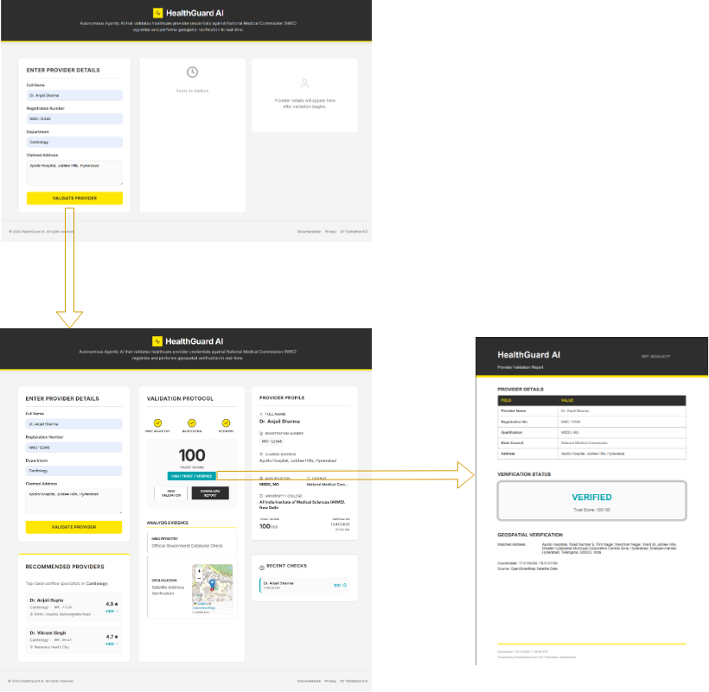
HealthGuard AI – End‑to‑End Verification Journey
This screen flow shows the end‑to‑end journey inside the HealthGuard AI dashboard:
Input Screen (left) – Network Manager enters provider name, registration number, specialty and clinic address, then clicks “Validate Provider” to trigger the check.
2. Validation Dashboard (middle) – Results appear in one view:
Trust Score (0–100) and overall VERIFIED / FLAGGED status
Provider profile card (identity, qualification, registry, address)
Evidence panels for registry lookup and map‑based geolocation
Recommended verified providers plus recent checks for quick audit
3. PDF Report (right) – A one‑click Provider Validation Report summarizes key fields, final status and geospatial evidence, giving FCU/compliance teams an auditable record.

Slide 12

